Slide 1

FINANACE DATA ANALYSIS
.

Slide 2
# TASKBAR:- * The task bar is present in the HOME, ABOUT, ACCOUNT ,BANK , MESSAGE. # CARD:- * Sum of the annual income in represent the card. *Sum Of the tax paid is represent the card. * Average of retirement_saving is represent the card. * Average of debit represent the card
.

Slide 3
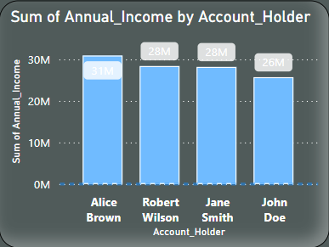
# GRAPHS:-
This graph show the sum of the annual_income by the account_holder and x axis is represent the Account holder and y I axis is the sum of annual income.

Slide 4
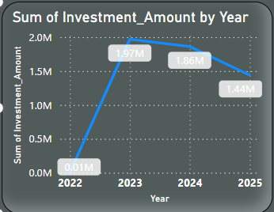
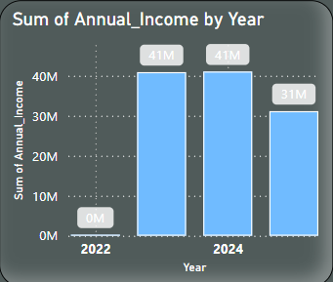
# GRAPHS
THE LINE graph show the sum of INVESTMENT BY THE YEAR WISE REPRESENT.
THE BAR graph show the sum of INCOME BY THE YEAR WISE REPRESENT.

Slide 5
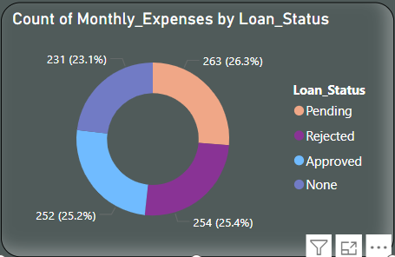
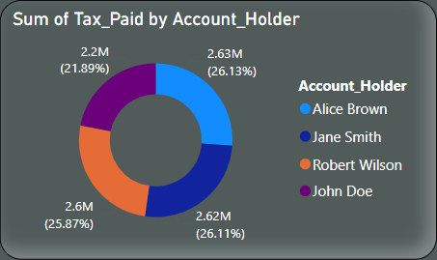
# GRAPHS
THE DONAT graph show the COUNT of MONTHLY EXPENSES BY THE LOAN_STATUS REPRESENT.
THE DONAT graph show the sum of TAX BY THE ACCOUNT_HOLDER REPRESENT THE DATA .

Slide 6
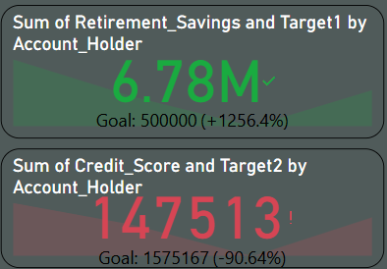
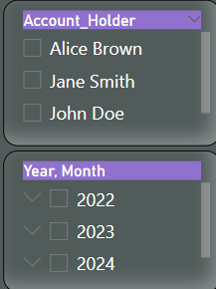


# GRAPHS
THE kpi show the sum of retirement saving BY THE account holder REPRESENT the target value.
THE kpi show the sum of credit score BY THE account holder REPRESENT the target value.
Slicer is created account holder and year that select the value of slicer to dashboard all data show only select value data

Slide 7
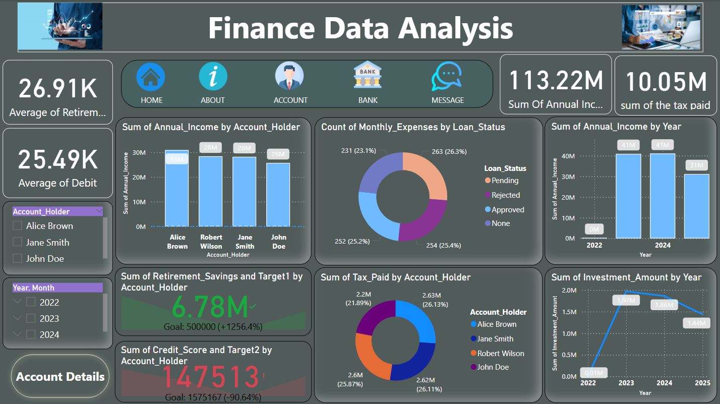
# GRAPHS
.

Slide 8
THANK YOU
.

